Slide 1
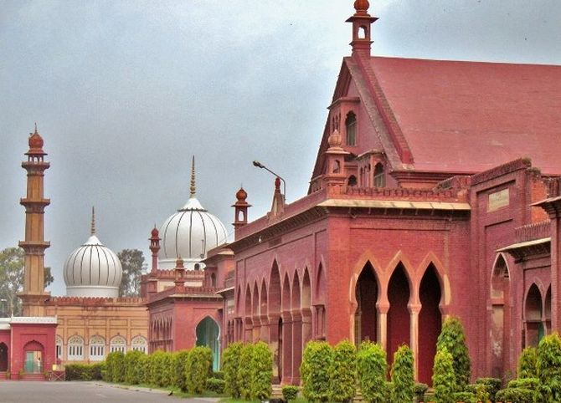


ALIGARH MUSLIM UNIVERSITY
2023-24
PROUD TO HAVE ASIA’S LARGEST LIBRARY “MAULANA AZAD LIBRARY”.

